Slide 1
Tax Preparation Course Introduction
Notes:
Instructor Notes:
This lesson is designed to introduce new volunteers to your district training program and could be part of your New Volunteer Orientation (if applicable) or at the start of classroom training
It assumes that New Volunteers would attend some form of classroom training
Instructors
Need to fill in their state information on Slide 7
Slides 8 and 9 are intentionally blank and need to have information added for your training program
Need to fill in the required practice returns from the NTTC Workbook on Slide 15
The NTTC recommends at least four practice returns to demonstrate competence with the software
Some slides have suggested talking points
They should be modified to meet the needs of our volunteers and your district
The District Training Coordinator/Instructors should review the content of all the slides and make modifications as necessary to support their training program objectives
This lesson focuses on the federal return
Instructors should add slides for state return training as necessary

Slide 2
Lesson Topics
VITA/TCE and Tax-Aide Courses
Required Tests and Problems
Available Materials and Resources
Certifications for Tax-Aide
Volunteer Responsibilities
Training Agenda

Slide 3
VITA/TCE Courses
Courses required of all volunteers
Volunteer Standards of Conduct (VSC)
IRS Publication 4961
Intake/Interview and Quality Review
IRS Publication 5101
Policy and Procedure Training in class*
*Limited case by case exceptions
Notes:
While the first two courses can be presented in a classroom setting, many districts have new volunteers and counselors study the material on their own, take and pass the exam on-line, and print and sign the Volunteer Agreement as part of New Volunteer Orientation prior to tax law/TaxSlayer training
IRS requires that all new volunteers must take the course on Intake/Interview and Quality Review
Policy and Procedure Training, however, is required to be presented by Instructors to all counselors, typically at orientation
District Coordinators may grant limited case by case exceptions but no blanket district or site exceptions may be granted

Slide 4
Counselor Tax Courses
Tax Law
Basic
Not required for Tax-Aide counselors
Advanced
Required for all Tax-Aide counselors
Optional specialty courses
Health Savings Accounts (HSA) certification
Military certification (not usual Tax-Aide Certification)
International certification (not usual Tax-Aide Certification)
Foreign Student certification (not usual Tax-Aide Certification)

Slide 5
IRS Materials
Pub 4012
Volunteer Resource Guide
Pub 4491
Volunteer Training Guide
Pub 17
Federal Income Tax For Individuals
IRS Forms and Publications applicable to training
Notes:
Both Pubs 4012 and 4491 have NTTC supplemental information to provide more details to aid Counselors

Slide 6
TaxSlayer Software Materials
TaxSlayer Pro is the software
TaxSlayer Practice Lab for all training
Practice software
Practice problems with answers
Training videos and recorded webinars
Training materials for download
Notes:
TaxSlayer Pro: cannot use personal computer to access
TaxSlayer Practice Lab: can use personal computer to access

Slide 7
Tax-Aide Materials
National Tax Training Committee (NTTC) Workbook
Training Exercises for classroom instruction
Practice problems and quizzes
Separate Instructor Guide to NTTC Workbook (electronic version only)
Qualifying Child/Qualifying Relative Resource tool for tax counselors
“Tri-fold” used during training and tax preparation

Slide 8
Tax-Aide Materials cont.
Resource Library on the AARP Portal
Volunteer Resource Guide with NTTC notes
Volunteer Training Guide with NTTC notes
Scope Manual
Tax-Aide Policies and Procedures
Many other helpful documents

Slide 9
State and Local Materials
List here any State and Local materials you use
[e.g. Michigan Taxpayers Assistance Manual]
[e.g. Michigan Tax Text]
[e.g. https://www.michigan.gov/taxes]
List here any State and Local Tax-Aide materials
[e.g User Guide for Michigan Returns]
Modify for your State and Local Materials
Notes:
This is the place to list local materials unique to your training area

Slide 10
Volunteer Resource Guide – Pub 4012
Written specifically for the VITA/TCE program
Contains everything needed to pass all tests
Will be available Online in October
Printed version will be delivered mid-November
Tax-Aide Recommends use of the NTTC Pub 4012 available in the Portal Library
Notes:
The idea of this slide is to demonstrate the value of the Resource Guide and get the volunteers to adopt Pub 4012 as their “Go To” reference not only during training but at the site throughout the tax season
Instructors can highlight the pages that they feel would illustrate the function and value of Pub 4012
Volunteers are encouraged to add any notes or highlighting to enhance their use of this publication

Slide 11
Volunteer Resource Guide – Pub 4012
NTTC-Modified Pub 4012 recommended
Online only, no printed version
Latest version always in Portal Library
Available mid-October with January Update
Best reference for Tax-Aide (only) scope items
NTTC version includes scope differences from IRS
Notes:
Areas to emphasize:
The value of the NTTC-Modified Pub 4012 and get the volunteers to adopt the modified guide
Instructors should have counselors practice with NTTC-modified Pub 4012 often
Instructors should practice using NTTC-modified Pub 4012 online
Pause during each class and have counselors find answers to posed questions, determine scope for a variety of situations and become familiar with the layout and format of the Guide
Becoming familiar now with the online version will save time during tax season
Benefit of online only: continually updated

Slide 12
Link and Learn Webpage
https://www.linklearncertification.com
Direct links to:
Online tests for certification
Training Lessons
Link and Learn On-line Lessons
IRS Forms and Publications site
Notes:
Have the counselors create an account and verify everyone can login
Remind counselors they will need to remember their username and password

Slide 13
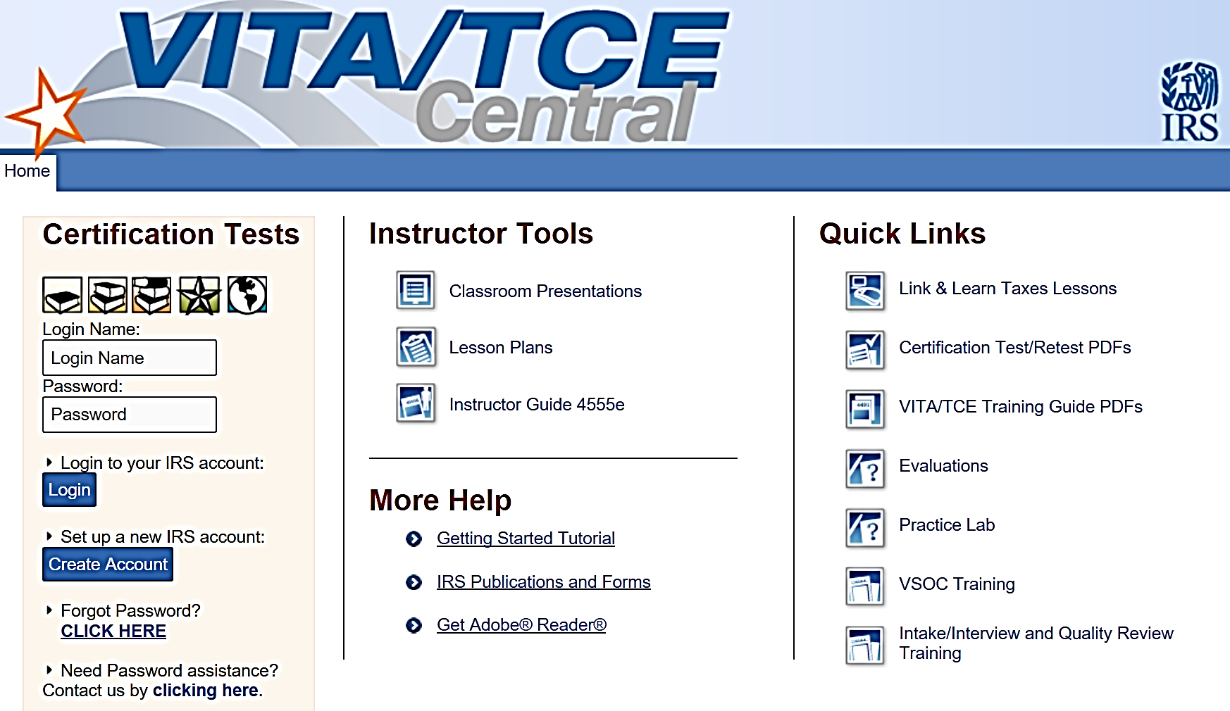
https://www.linklearncertification.com
Access online tests here
Notes:
Having all new volunteers log-in and explore this site under Instructor direction would be an excellent topic at New Volunteer Orientation
Instructions for logging in and taking the tests online can be found in the Portal Library
Screen shot may be out of date when 2019 Tax Test goes live.

Slide 14
Tax-Aide Certification Process
Counselors must pass three tests to meet IRS/AARP Tax-Aide certification requirements
Volunteer Standards of Conduct (VSC) Test
IRS Intake/Interview & Quality Review Test
Advanced Test
Each test must be passed with score of 80% or better
One retest available for each test

Slide 15
Certification Process
Certification also requires that you prepare the following practice exercises:
A
B
C
D
Exercises must be completed as “ready to file” and will be reviewed by an Instructor
Notes:
The number of required exercises may be established by your State Coordinator
AARP Tax-Aide recommends a minimum of four exercises
The specific exercises maybe determined by the State Management Team
If not specified, Instructors may want to select exercises that most reflect those the volunteers will encounter at their sites during tax season
The NTTC Workbook has a variety of exercises to choose from and exercises can be modified as necessary to meet each District’s needs

Slide 16
Tax Return Preparation and Filing Process
All taxpayers must complete the Intake Booklet
Counselors and Reviewers review with taxpayer and annotate additional information
All returns completed on computer
TaxSlayer® software supplied by IRS
All returns must have Quality Review
Second independent counselor reviews completed return for accuracy
Tax returns are e-filed whenever possible
Each taxpayer signs return

Slide 17
Volunteer Responsibilities
Comply with all Tax-Aide Policies and Procedures
Stay within scope of program
If Counselor is unfamiliar with or not trained on a tax situation, return is out of scope for that Counselor
Notes:
These are the responsibilities covered in AARP Tax-Aide Policies and Procedures
Instructor can add additional responsibilities established by their districts
If return is knowingly out of scope, there is no coverage

Slide 18
Volunteer Responsibilities
Verify that the taxpayer understands their return
Communicate that the tax return is client’s responsibility
Protect taxpayer’s confidentiality and security
Do not retain any taxpayer data
Follow site procedures and policies
Notes:
All material is this slide deck is CORE!

Slide 19
Volunteer Responsibilities
Become familiar with and use resources
IRS Pubs: emphasis on NTTC Pub 4012
AARP resource materials and IRS help resources
State materials and help resources
Fellow counselors
AARP Tax-Aide Cybertax Alerts
Notes:
These are the responsibilities covered in AARP Tax-Aide Policies and Procedures
Instructor can add additional responsibilities established by their districts

Slide 20
Volunteer Protection Act of 1997
Certified volunteers not liable when:
Received IRS/AARP Foundation Tax-Aide Training
Action is not wilful
Act within scope of program and training
AARP Foundation Tax-Aide policies and procedures are followed

Slide 21
Training Agenda
Notes:
This slide can be used to show the class agenda or schedule and additional slide can be added as necessary

Slide 22
Pre-Class Requirements
Notes:
Instructors should list those items that they want volunteers to complete prior to coming to the first day of class
Items could include:
Reviewing the Course Objective chapter of Pub 4491 and briefly familiarizing themselves with the Training Guide’s contents
Completing the Volunteer Standards of Conduct Course (Pub 4961) and certification exam on Link and Learn Taxes
Completing the Intake/Interview & Quality Review Course (Pub 5101) and taking the certification exam on Link and Learn Taxes
Printing a copy of the Volunteer Agreement from Link and Learn Taxes showing they passed one or both exams above.
Alternatively they could be asked to fill out the Volunteer Agreement form in Pun 6744 and bring it to class. This could also be done during their orientation if applicable
Alternatively, they can take the two tests and submit the Volunteer Agreement after they complete their certifications
Open and assemble their Pub 4491 and familiarize themselves with the contents
Open and assemble their Pub 4012 and familiarize themselves with the contents – this will be late January

Slide 23
Course Introduction
Questions?
Comments…

